Slide 1
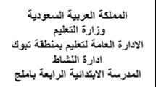
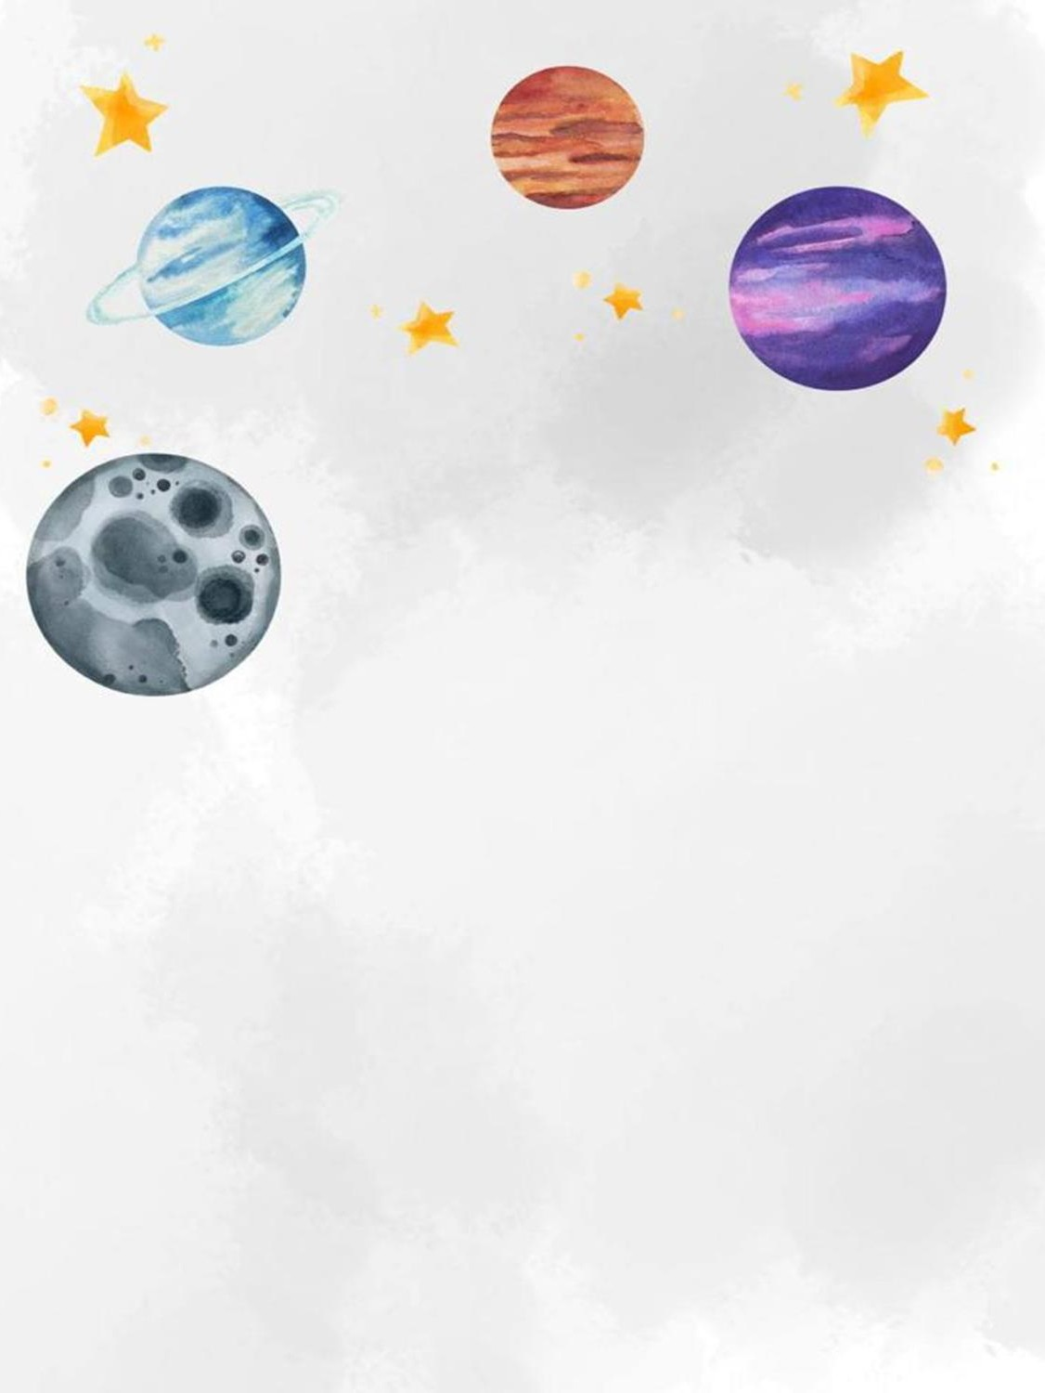
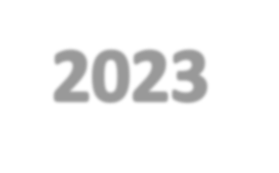
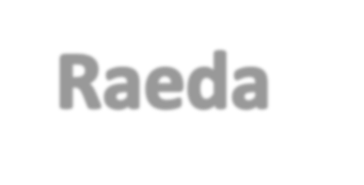
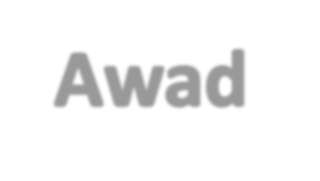
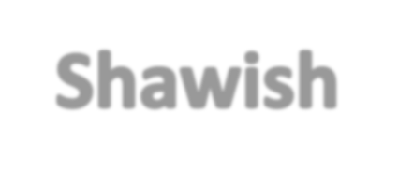
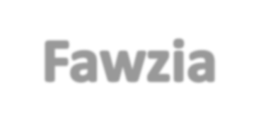
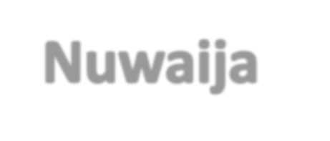
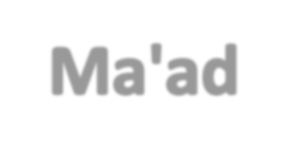
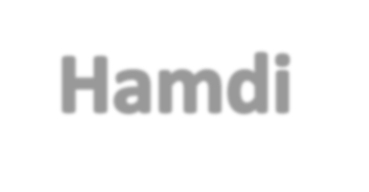
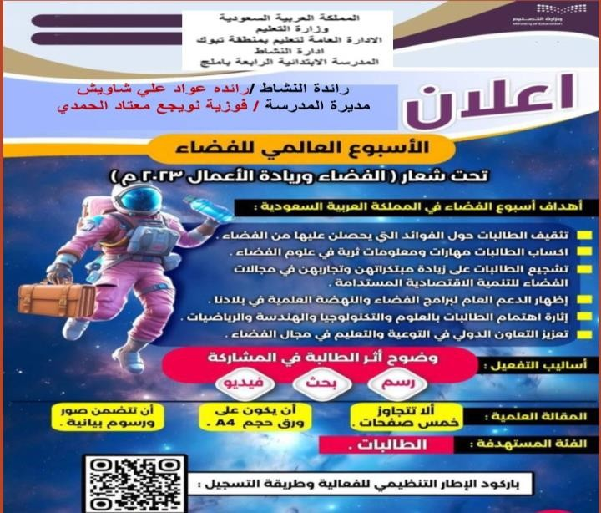

Slide 2
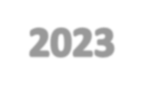
Program Goalsm
1/ Educating studentsabout the benefitsthey get fro
2/ Providing male and female students with rich skills and information in space science
3/ Encouraging students to increase their innovations and experiences in the fields of space for sustainable economic
4/ Showing public support for space programs and the
5/ Arouse students’ interest in science, technology, engineering, and mathematicsscientific advancement in our country development 6/Enhancing international cooperation in awareness and education in the field of space
Implementation mechanism | Implementi ng class | Beneficiary category | the date | the field
1/Announcing | Activity | Female | October | scientific
the program | leader | students | 4 to
2/ Follow | And | who wish to | October
posts | science | participate | 10
3/Meekness | teacher | in Space
4/ Collecting | Nahla | Week
contributions | Mohamme
from female | d Al-
students | Marwani

Slide 3
Sunday Developing awareness of the importance of space science and astronomy on life on Earth through scientific meetings presented in
PowerPoint For World Space Week magazine under the
slogan (Space and entrepreneurship)
https://drive.google.com/drive/fo •
lders/1IN5GIuaJIZg78WP6OYBhnL 8nGvG-kcSR?usp=sharing

Slide 4
Monday Radio entitled
(Space and Entrepreneurship)
With articles
https://drive.google.com/driv • e/folders/176pMzPxIMHJBH4 HcrbBYMUrIvyrDO_oj?usp=sh
aring

Slide 5
Tuesday Artistic paintings, coloring drawings
https://drive.google.com/dri • ve/folders/1LtIIpkJuTW8svRS 668ojXxtUtCmtpDzo?usp=sh
aring

Slide 6
Wednesday Video clips of female students were shown
https://drive.google.com/dri •
ve/folders/1mYIYJ_zM- W43AXIgBcGVSVJ6j_tpkCU9?
usp=sharing

Slide 7
Activating World Space Week on
Twitter social media
https://x.com/moe_tbk_06_0090 •
/status/1712040653691953609?s
=46&t=jk49tL5iS8vOldurO1vafAht
tps://x.com/moe_tbk_06_0090/st •
atus/1711789249064837495?s=4
6&t=jk49tL5iS8vOldurO1vafA

Slide 8
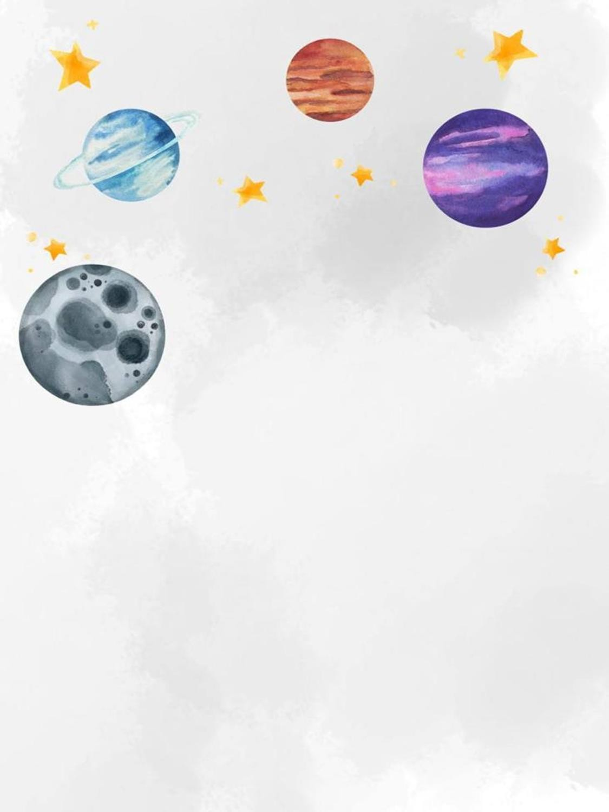
https://x.com/moe_tbk_06_0090 •
/status/1711615293116608566?s
=46&t=jk49tL5iS8vOldurO1vafAht
tps://x.com/moe_tbk_06_0090/st •
atus/1712172074645549481?s=4
6&t=jk49tL5iS8vOldurO1vafA

Slide 11
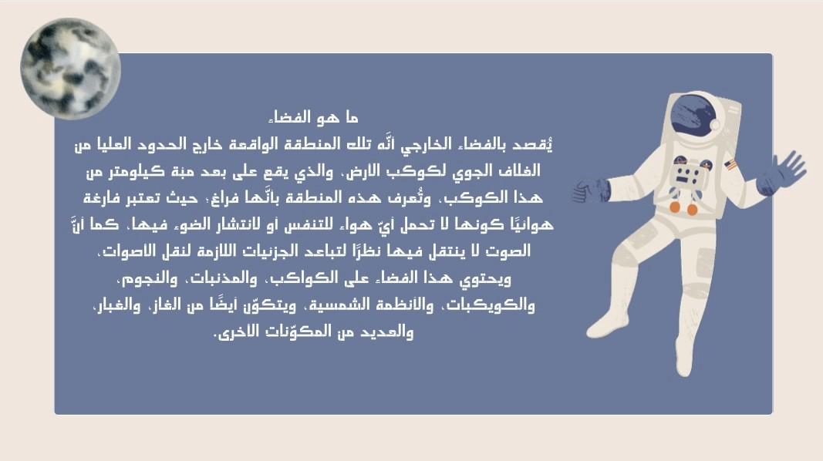

Slide 16
